Slide 1
Boolean functions
Exercise 7.2
Simplify the following Boolean functions of 4 variables given by their values 1, using Quine’s method.
f2(1,1,0,1) = f2(0,1,0,1) = f2(0,1,0,0) = f2(0,0,0,0) = f2(0,0,1,0) = f2(1,0,1,1) = f2(1,0,0,1) = f2(0,0,1,1) = 1;

Slide 2
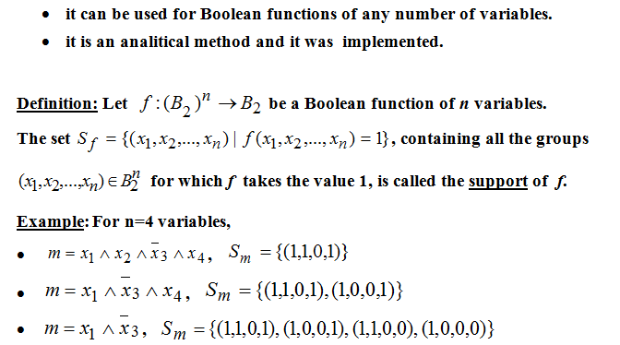
Quine’s method

Slide 3
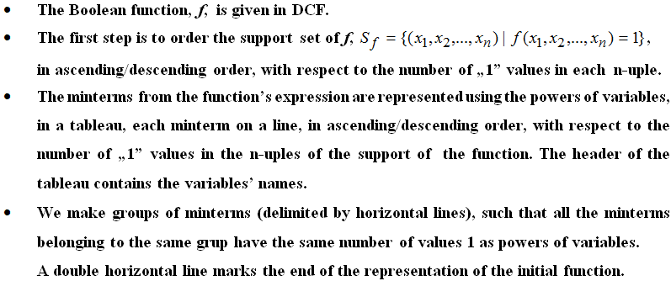

Slide 4
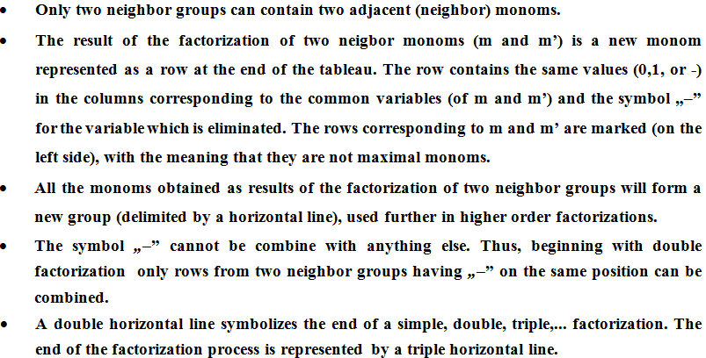

Slide 5
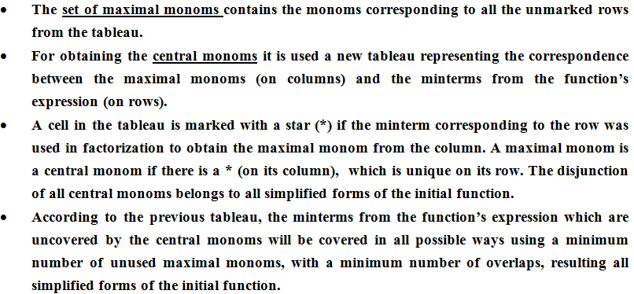

Slide 6
f2(1,1,0,1) = f2(0,1,0,1) = f2(0,1,0,0) = f2(0,0,0,0) = f2(0,0,1,0) = f2(1,0,1,1) = f2(1,0,0,1) = f2(0,0,1,1) = 1; f2
f2 = m13 v m5 v m4 v m0 v m2 v m11 v m9 v m3
f2 = x1x2x3x4 v x1x2x3x4 x1x2x3x4 v x1x2x3x4 V x1x2x3x4 v x1x2x3x4 x1x2x3x4 v x1x2x3x4
We find the support set of the function f
the support of f is the reunion of the supports of the minterms
a conjunction of variables if called a monom
a monom which contains all n variables of a function is called a canonical monom or a minterm
the support of f is represented in descending order, with respect to the number of “1” values in each 4-uple
Sf = {(x1, x2, …, xn)| f(x1, x2, …, xn) = 1} =>
Sf = {(1, 1, 0, 1), (1,0,1,1), (0,1,0,1), (1,0,0,1), (0,0,1,1), (0,1,0,0), (0,0,1,0), (0,0,0,0)

Slide 7
Sf = {(1,0,1,1), (1, 1, 0, 1), (0,0,1,1), (0,1,0,1), (1,0,0,1), (0,1,0,0), (0,0,1,0), (0,0,0,0)} Step2: The factorization process
Representation | Group | Mark | x1 | x2 | x3 | x4
 | I | ✓ | 1 | 0 | 1 | 1 | m11
 |  | ✓ | 1 | 1 | 0 | 1 | m13
 | II | ✓ | 0 | 0 | 1 | 1 | m3
 |  | ✓ | 0 | 1 | 0 | 1 | m5
 |  | ✓ | 1 | 0 | 0 | 1 | m9
 | III | ✓ | 0 | 0 | 1 | 0 | m2
 |  | ✓ | 0 | 1 | 0 | 0 | m4
 | IV | ✓ | 0 | 0 | 0 | 0 | m0
Simple Factorization | V = I + II |  | - | 0 | 1 | 1 | m11 v m3 = max1 = x2x3x4
 |  |  | 1 | 0 | - | 1 | m11 v m9 = max2 = x1x2x4
 |  |  | - | 1 | 0 | 1 | m13 v m5 = max3 = x2x3x4
 |  |  | 1 | - | 0 | 1 | m13 v m9 = max4 = x1x3x4
 | VI = II + III |  | 0 | 0 | 1 | - | m3 v m2 = max5 = x1x2x3
 |  |  | 0 | 1 | 0 | - | m5 v m4 = max6 = x1x2x3
 | VII = III + IV |  | 0 | 0 | - | 0 | m2 v m0 = max7 = x1x2x4
 |  |  | 0 | - | 0 | 0 | m4 v m0 = max8 = x1x3x4

Slide 8
M(f) = {max1, max2, max3, max4, max5, max6, max7, max8}
the set of maximal monoms - 8 simple factorizations
max1 = x2x3x4; max2 = x1x2x4; max3 = x2x3x4; max4 = x1x3x4; max5 = x1x2x3; max6 = x1x2x3; max7 = x1x2x4; max8 = x1x3x4
Minterms/max monoms | max1 | max2 | max3 | max4 | max5 | max6 | max7 | max8
m11 | * | *
m13 |  |  | * | *
m3 | * |  |  |  | *
m5 |  |  | * |  |  | *
m9 |  | * |  | *
m2 |  |  |  |  | * |  | *
m4 |  |  |  |  |  | * |  | *
m0 |  |  |  |  |  |  | * | *
There is no "*" which is unique on its row => there are no central monoms => C(f) = ∅, third case of simplification.

Slide 9
To identify the simplified form(s) we have to choose a function h(x1, x2, x3, x4), as simple as posible, such that they cover all the minterms (m11, m13, m3, m5, m9, m2, m4, m0). We find a unique simplified form of f, fs. fs1(x1, x2, x3, x4) = max2 v max3 v max5 v max8 = x1x2x4 V x2x3x4 V x1x2x3 V x1x3x4 fs2(x1, x2, x3, x4) = max1 v max4 v max6 v max7 = x2x3x4 V x1x3x4 V x1x2x3 V x1x2x4
Simplified form of f

